Slide 1


DDoS Attack Detection
A Distributed Denial-of-Service (DDoS) attack is a malicious cyberattack that aims to disrupt a computer or network resource by overwhelming it with traffic from multiple sources.
This is typically achieved using a botnet, a network of compromised devices controlled by an attacker to flood the target system with traffic, rendering it unable to handle legitimate requests.
by PRATIK BAGADE

Slide 2

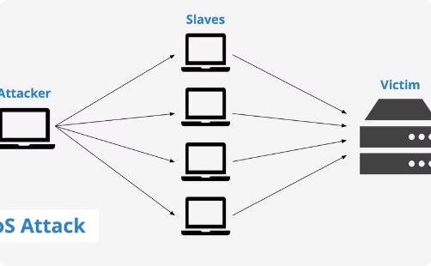

How a DDoS attack works:
DDoS attacks come in various forms, including SYN floods, HTTP floods, and DNS amplification.
Attackers are targeting critical infrastructure, including power grids and financial institutions.
1
Botnet creation
2
Traffic generation
Attackers create a network of compromised devices (bots) by infecting them with malware.
The attacker instructs the bots to send a massive amount of traffic to the targeted system.
3
Traffic flood
4
System overload
The bots overwhelm the targeted system with traffic, making it difficult to handle legitimate requests.
The targeted system becomes overwhelmed and unable to function properly.

Slide 3

Detecting DDoS Attacks
Detecting DDoS attacks requires monitoring network traffic for abnormal patterns. These anomalies may include sudden spikes in traffic, unusual source addresses, and unexpected protocol activity. Early detection is crucial for mitigating the impact of an attack.
1
Monitoring Network Traffic
Observe network traffic for abnormal patterns and fluctuations.
2
Analyzing Traffic Data
Use security tools and analytics to identify suspicious activity.
3
Identifying Anomalies
Look for unusual source addresses, traffic spikes, and unexpected protocol usage.

Slide 4




Techniques for DDoS Attack
Botnets
Malware
Scripting
Amplification Attacks
Botnets are networks of compromised devices used to launch attacks.
Malware is software designed to harm or exploit systems.
Scripting is used to automate attack processes.
Amplification attacks use third-party services to amplify traffic.

Slide 5




Implementing Mitigation Strategies
Firewalls
Intrusion Detection/Prevention Systems (IDS/IPS)
Load Balancing
Content Delivery Networks (CDNs)
Act as a gatekeeper, filtering and blocking malicious traffic to protect your network.
Distributes traffic across multiple servers, preventing any one server from becoming overloaded.
Deliver content from multiple locations, reducing latency and server load for improved performance.
Monitor network activity for suspicious patterns and block threats before they reach your systems.

Slide 6
Real-Time DDoS Attack Detection Examples
Excessive Network Traffic
Uncommon Network Protocols
Slow Website Performance
Sudden spikes in traffic from unusual sources can indicate a DDoS attack.
Unusual or unexpected network protocols, like UDP floods, can signal a DDoS attack.
Website performance drops or increased load times can be a sign of a DDoS attack overwhelming server resources.
Unusual Server Load
Alerting Systems
Sharp increases in server CPU or memory utilization, even without additional traffic or application activity, may indicate a DDoS attack.
Monitoring tools like IDS or SIEM systems can trigger alerts based on predefined rules and patterns, indicating potential DDoS attacks.

Slide 7
Why MySQL for DDoS Detection
MySQL can play a crucial role in DDoS attack detection by providing a database infrastructure for storing and analyzing network traffic data. This data can include information about the source and destination of network requests, timestamps, and other relevant metrics.
Here's how MySQL helps in DDoS detection:
1. **Traffic Logging:** MySQL can store detailed logs of network traffic, enabling security teams to track network activity and identify unusual patterns.
2. **Anomaly Detection:** By analyzing historical traffic data, MySQL can be used to identify anomalies that might indicate a DDoS attack. This involves comparing current traffic patterns with established baselines and flagging significant deviations.
3. **Alerting and Response:** MySQL can trigger alerts when suspicious activity is detected, allowing security teams to take immediate action to mitigate the attack. This might involve blocking traffic from malicious sources, adjusting network configurations, or implementing other countermeasures.
4. **Attack Analysis:** MySQL provides a platform for analyzing DDoS attack data, helping security teams understand the nature of the attack and develop more effective mitigation strategies for future incidents.
MySQL stands out as a preferred choice for DDoS detection due to its proven reliability, scalability, and cost-effectiveness. Compared to other databases, MySQL offers superior performance for handling large volumes of network traffic data, essential for real-time monitoring and analysis. Its robust transaction capabilities ensure data integrity, critical for accurate detection and mitigation of DDoS attacks. Furthermore, MySQL's open-source nature and extensive community support provide a cost-effective solution compared to proprietary alternatives.

Slide 8
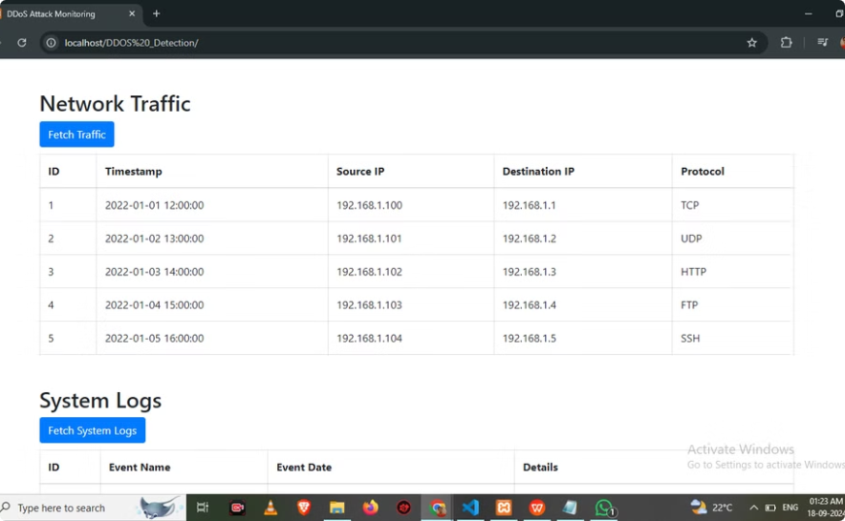
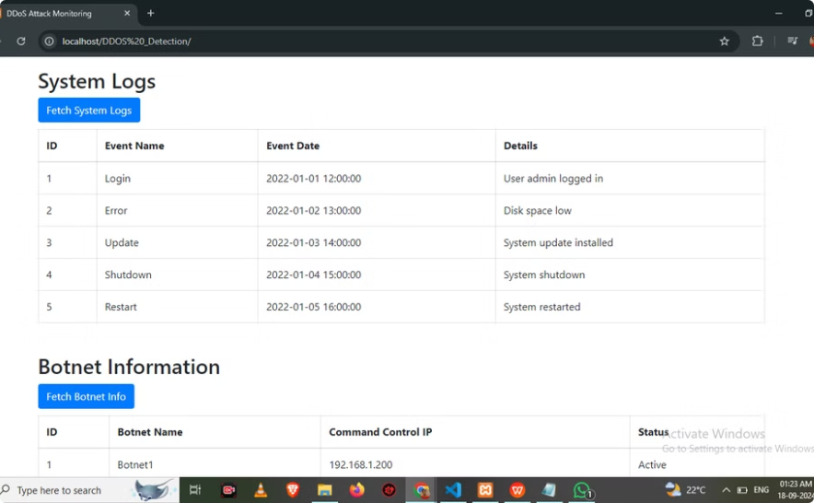
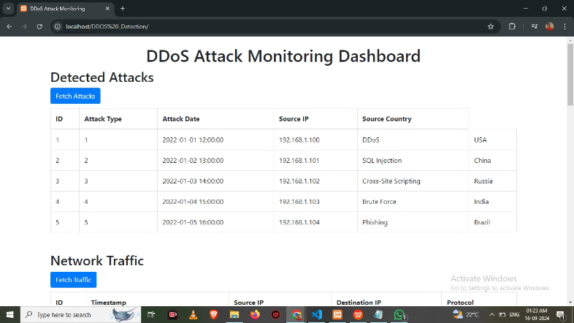
Project Outputs

Slide 9
Conclusion
This presentation outlined the key considerations for effective DDoS attack detection, emphasizing the role of MySQL in this crucial process. We explored the various benefits of using MySQL, including its reliability, scalability, and cost-effectiveness, making it a powerful tool for safeguarding networks from malicious attacks.

